Slide 1




Annex 3.2.1: Quiz on saving water Part of D.3.1.2 Educational materials
Notes:
To display correct answers, use slide show mode

Slide 2
Why talk about water and its conservation?
Population growth and the resulting increase in consumption and waste production on a global scale place the issue of resources, including water, at the center of the scientific and political debate on sustainable development.
In fact, the planet's resources are limited, as is its resilience to the impacts of human activities.

Slide 3
Increase in water withdrawals for different sectors, 1960–2014
Source: The United Nations World Water Development Report 2024: water for prosperity and peace

Slide 4
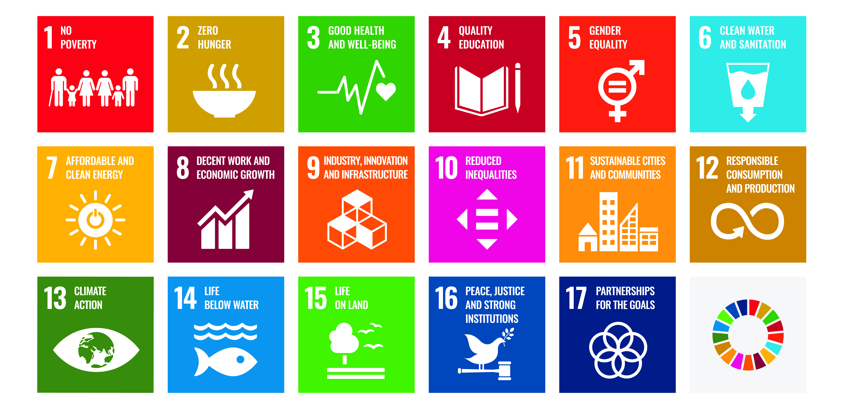
The United Nations Sustainable Development goals and the focus on water
Source: United Nations website (https://www.un.org/sustainabledevelopment/)
Source: The United Nations World Water Development Report 2024: water for prosperity and peace

Slide 5
Do you know how much water we have available on Earth?
And how much do you consume on average?
And how could you consume less?
Let’s find out together!

Slide 6
Freshwater
All human activities need FRESHWATER, that is, water with less than one gram of dissolved salts per liter. What is the percentage of FRESHWATER AVAILABLE on our planet?
Less than 1%
3%
33%
About 50%
To know more:
https://education.nationalgeographic.org/resource/freshwater-access/

Slide 7
Water stress
High domestic, agricultural, and industrial consumption, inadequate infrastructure, climate change, and surface water contamination all contribute to WATER STRESS, that is, a situation in which the quantity of water required for human activities is greater than that available.
A country's level of water stress can be determined by calculating the WATER STRESS INDEX (WSI), which compares the amount of water abstracted to the amount of available water:
WSI = (amount of withdrawn freshwater/amount of available freshwater) * 100

Slide 8




Water Stress
Which of these nations is affected by the HIGHER WATER STRESS INDEX, according to the European Environment Agency?
Czechia
Slovakia
Italy
Slovenia
To know more:
https://www.eea.europa.eu

Slide 9

Water Stress
Which of these nations is affected by the LOWER WATER STRESS INDEX, according to the European Environment Agency?
Czechia
Slovakia
Germany
Slovenia
To know more:
https://www.eea.europa.eu

Slide 10
Freshwater use
We need freshwater for drinking, sanitation, agriculture, electricity generation,…
What is the amount of WATER DAILY USED by a European citizen, on average?
Less than 15 L
About 50 L
88 L
About 150 L
To know more:
https://madeblue.org/en/how-much-water-do-you-use-per-day/

Slide 11
Water management
Which of these streams could be considered UNCONVENTIONAL WATER RESOURCES?
Rainwater
Greywater (shower, tap and washing machine drains)
Reclaimed water (wastewater treatment plant effluents)
All of these streams
To know more:
https://www.iwa-network.org/

Slide 12
Water management
Which of these needs could be satisfied by GREYWATER REUSE?
Personal care
Plant irrigation
Toilet flushing
Dish washing
To know more:
https://www.iwa-network.org/

Slide 13
Water saving
The first step towards circular and sustainable water management is water saving, introducing less of this resource into the cycle and encouraging circular pathways.
What is the amount of WATER YEARLY WASTED by a tap leaking a drop of water per second?
Less than 20 L
312 L
About 1,500 L
More than 8,000 L
To know more:
1 drop/s = 0,00005 L/s * 60 s/min * 60min/h * 24h/d * 365d/y = 1,577 L/y

Slide 14
Water saving
Which of these action is NOT A GOOD PRACTICE for water saving?
Taking a shower instead of a bath
Rinsing dishes before placing them in the dishwasher
Using double flush toilet
Avoiding useless water flowing in personal care
To know more:
https://watereurope.eu/wp-content/uploads/2023/11/WE-Water-Vision-2023_online.pdf

Slide 15
Water saving
Which of these action is considered A GOOD PRACTICE for water saving?
Letting the water run when washing hands
Watering plants at noon
Washing the car every day
Using dishwashers and washing machines only fully loaded
To know more:
https://watereurope.eu/wp-content/uploads/2023/11/WE-Water-Vision-2023_online.pdf

Slide 16
Water saving
Which of these good practices could grant the HIGHER DAILY WATER SAVING?
Turning off the tap when washing teeth
Turning off the tap while shaving
Using double flush toilet
Washing fruit and vegetables by soaking instead of using running water
To know more:
https://watereurope.eu/wp-content/uploads/2023/11/WE-Water-Vision-2023_online.pdf

Slide 17
Water saving
How many liters of water could you save by recovering cold water while waiting for hot water for your shower?
2 L
About 10 L
Up to 20 L
More than 30 L
To know more:
https://watereurope.eu/wp-content/uploads/2023/11/WE-Water-Vision-2023_online.pdf

Slide 18
Water saving
How much water could you save taking A SHOWER INSTEAD OF A BATH?
No more than 30%
Up to 50%
Up to 70%
More than 90%
To know more:
https://watereurope.eu/wp-content/uploads/2023/11/WE-Water-Vision-2023_online.pdf

Slide 19
